Slide 1
UNIT – I
Introduction to Web Technologies

Slide 2
Syllabus
INTRODUCTION TO WEB TECHNOLOGIES
HTML: Getting started with HTML, Why HTML, Tags and Elements, Attributes, Properties, Headings list, Links, Tables, Images, HTML Form, Media (Audio, Video), Semantic HTML5 Elements.
CSS: Why CSS, Types of CSS, How to use CSS, Properties, Classes, Child-Class (Nested CSS), Colors, Text, Background, Border, Margin, Padding, Positioning (flex, grid, inline, block), Animation, Transition.
BOOTSTRAP: Why Bootstrap, CSS over Bootstrap, How to Use Bootstrap, Bootstrap Grid System, Bootstrap Responsive, Bootstrap Classes, Bootstrap Components (i.e., Button, Table, List, etc.), Bootstrap as a Cross Platform.
W3C: What is W3C , How W3C handles/Supports Web Technologies.

Slide 3
Web Technology
“Methods by which computer communicate with each other through the use of markup languages and multimedia packages”
Techniques using which we can access various resources on the Web.
It’s related to the interface between web servers and their clients.
It includes markup languages, programming interfaces and languages, and standards for document identification and display.

Slide 4
Web Technology
Web Technology can be Classified into the Following Sections:
World Wide Web (WWW): is an information space where documents and other web resources are identified by Uniform Resource Locators (URLs)
Web Browser: The web browser is an application software to explore www (World Wide Web).
Web Server: Web server is a program which processes the network requests of the users and serves them with files that create web pages.
Web Pages: A webpage is a digital document that is linked to the World Wide Web and viewable by anyone connected to the internet has a web browser.
Web Development: Web development refers to the building, creating, and maintaining websites.

Slide 5
Web Technology
Web Development can be Classified into Two Ways:
Frontend Development
Backend Development

Slide 6
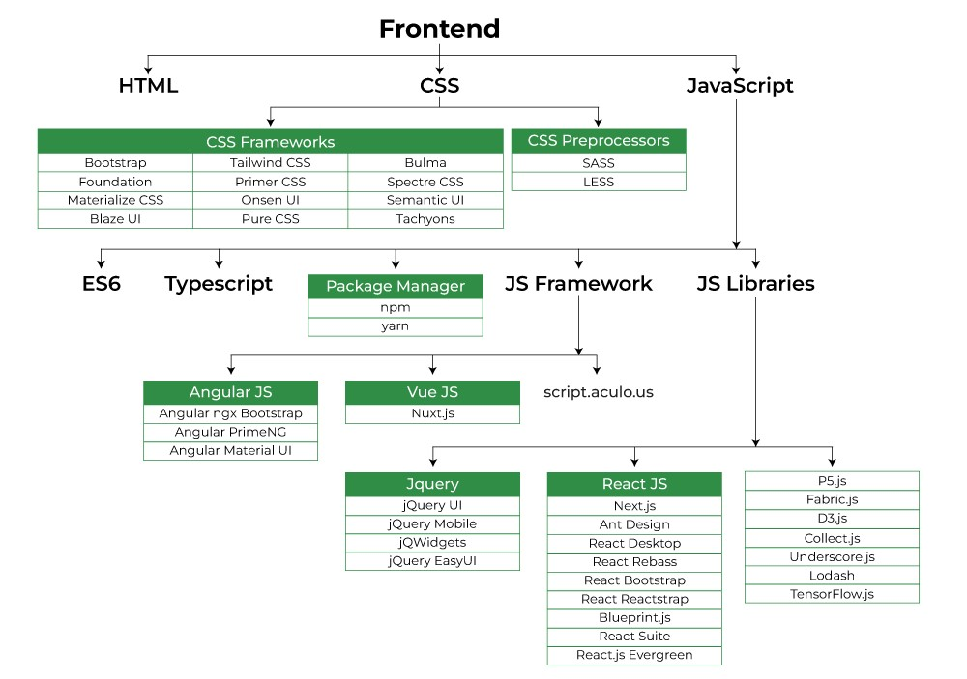
Frontend Development

Slide 7
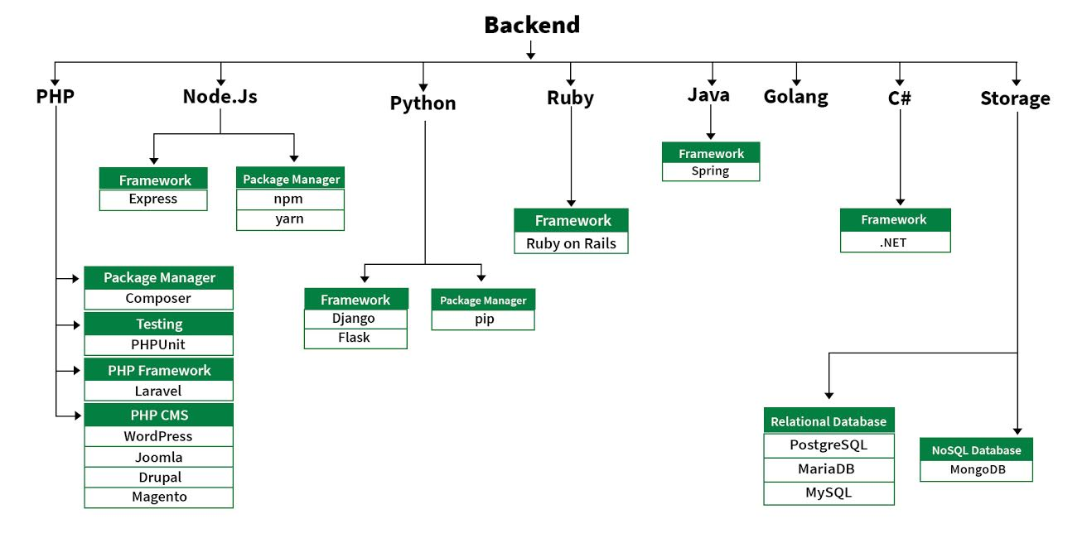
Backend Development
Notes:
https://www.geeksforgeeks.org/web-technology/

Slide 8
According to Microsoft.com, some examples of web technologies include:
Mark-up languages including HTML, CSS, XML, CGI
Communication protocol- HTTP;
Programming Languages and Technologies which help in creating applications for the web; some of the languages are Perl, C#, Java and Visual Basic .Net;
Web servers and server technologies which facilitate request handling : IIS, Apache and PHP, ASP;
Databases- MySQL
Business applications customized for specific execution of tasks on a network.

Slide 9
Introduction to Web Technology
Web
The web is collection of documents that are interconnected by hyper links.
These documents are accessed by web browsers and provided by web servers.
WWW (World Wide Web)
The WWW sometimes only pronounced simply as Web, is a way of retrieving information over the internet.
HTTP protocol is used by the web to transmit data over the internet.

Slide 10
Cont..
Website
A website is made up of web pages. These web pages also known as web documents are interconnected with each other with the help of hyperlinks.
Such webpages can be accessed by using various web browsers like IE, Chrome, Firefox etc.. The web document can contain tables, simple text, graphics etc..
Web sites are usually created for commercial purpose. There are various extensions of web sites depending upon their prime purpose.
.com – Commercial
.org – Organization
.net – Network
.biz – Business
.edu – Education

Slide 11
Cont..
Website :
Also there are some extensions depending upon the countries
.in - India
.uk – United Kingdom
.us – America
.nz – New Zealand

Slide 12
Cont..
For any Website-there are basically 2 important aspect
Web Designing
Web Development (Scripting)
Web Designing
As the basic intention of the website is always commercial, it's necessary
The website should be user-friendly and attractive.
For designing purposes, various scripting languages like HTML, CSS, and
Software tools like Photoshop, CorelDraw, and flash are used.

Slide 13
HTML

Slide 14
HTML
Getting started with HTML
Why HTML
Tags and Elements
Attributes, Properties, Headings list, Links, Tables, Images
HTML Form
Media (Audio, Video)
Semantic HTML5 Elements.

Slide 15


Slide 16
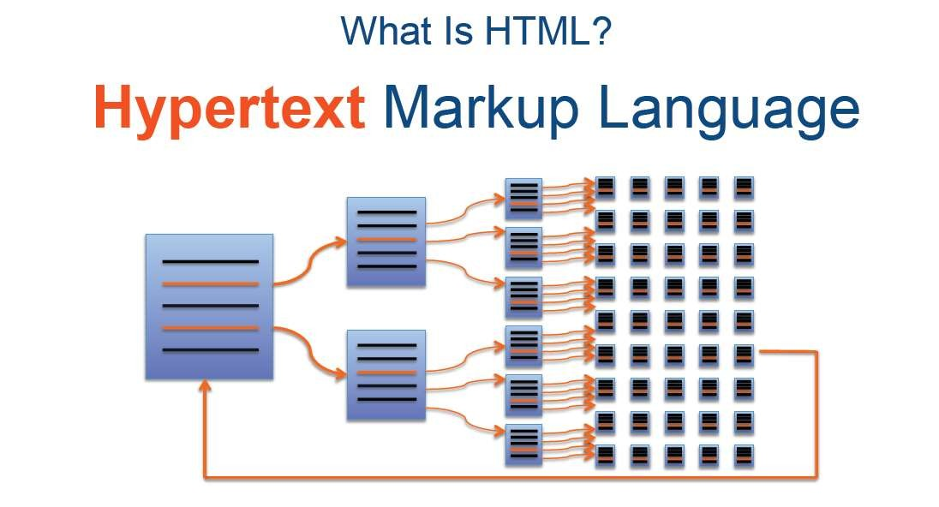
Web pages also known as web documents are interconnected
with each other with the help of hyperlinks.

Slide 17
HTML
HTML (Hyper Text Markup Language)
Structure of HTML document.
HTML document contain two main parts
Head :
The element contains title and matadata of a web document.
Used to declare variables and functions in scripting languages. These variables and functions are
then accessible throughout the page.
Body
Element contain the information which we like to display on a web page. All text to be displayed
and control creation is done in this section.

Slide 18
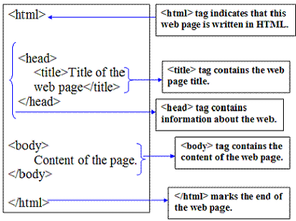
HTML
Client side and static web page development using HTML
Structure of html document
2/12/2025

Slide 19
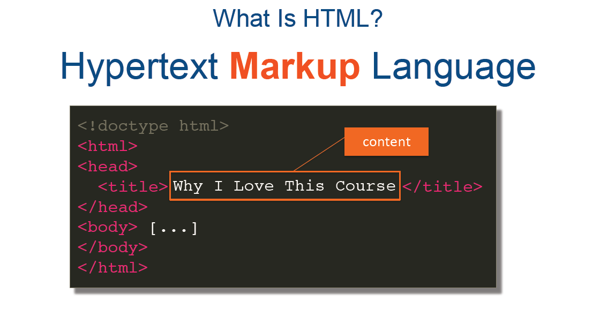

Slide 20
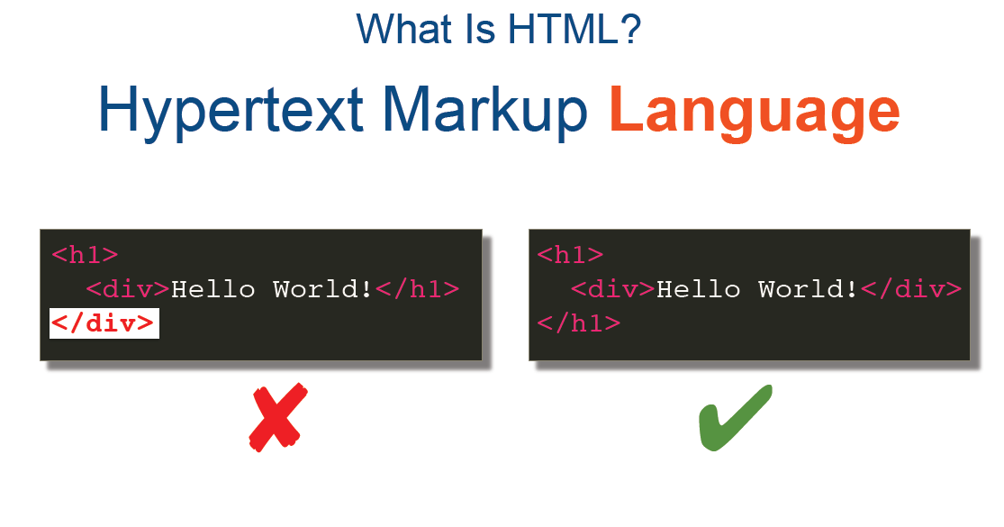

Slide 21
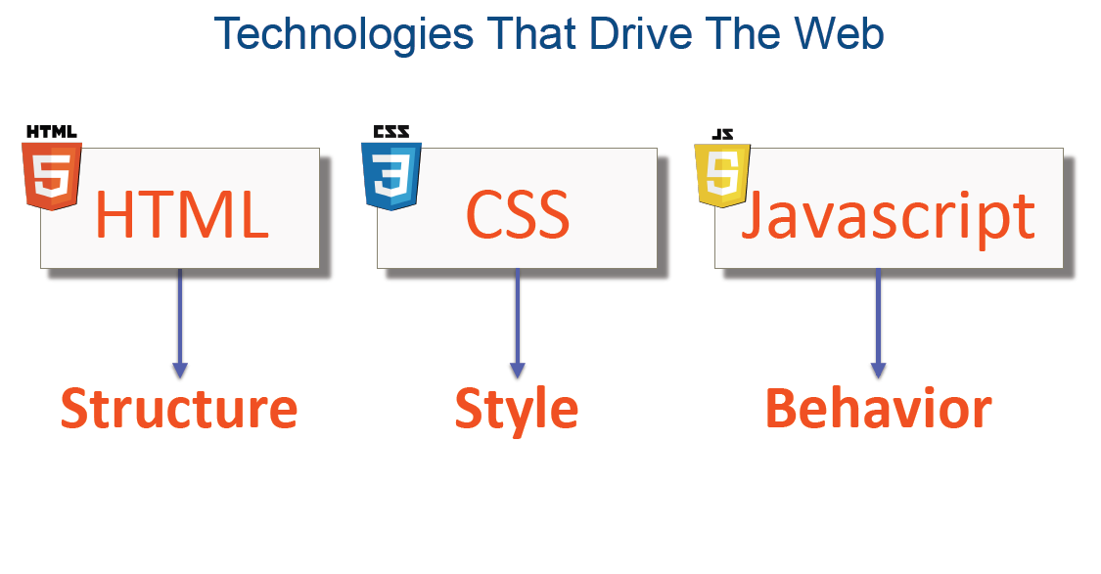

Slide 22
HTML Tags
An HTML code begins with the tag <HTML> and finishes with </HTML>.
Tags are enclosed in angular brackets i.e. '<' and '>'.
A complete tag is called as an element.
A tag has three major parts: opening tag, content and closing tag.
Syntax: <tagname>content</tagname>

Slide 23
HTML Tags
There are two types of tags
Empty tag
A tag which does not have any end tag. Example: <hr>, <br>
Paired tag
A tag which has starting tag as well as ending tag. Example: <h1>content</h1>

Slide 24
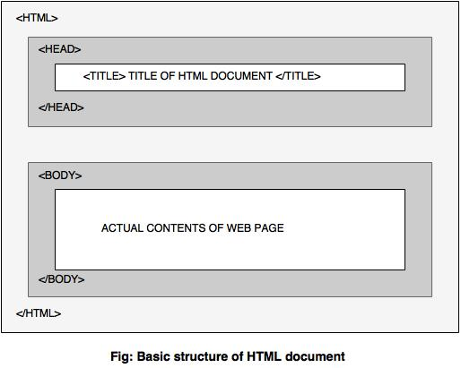
Basic Structure of HTML

Slide 25
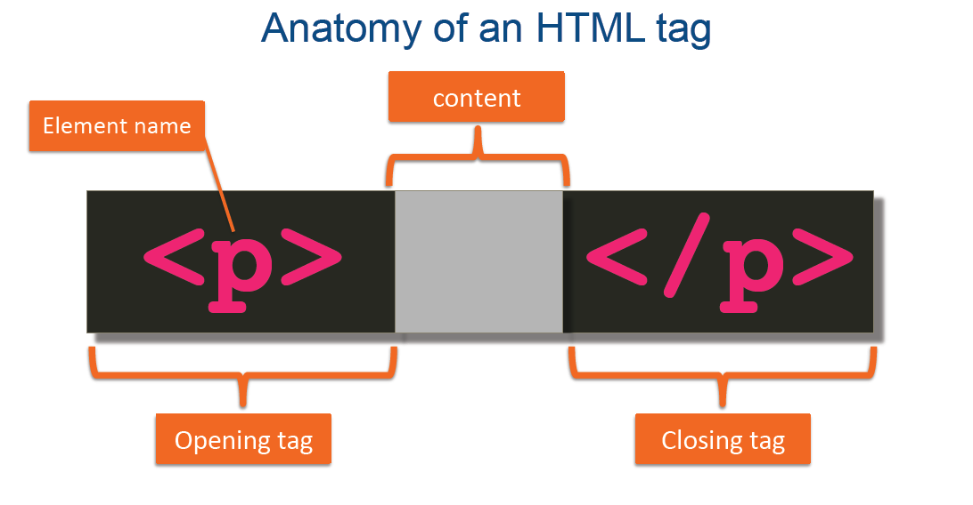

Slide 26
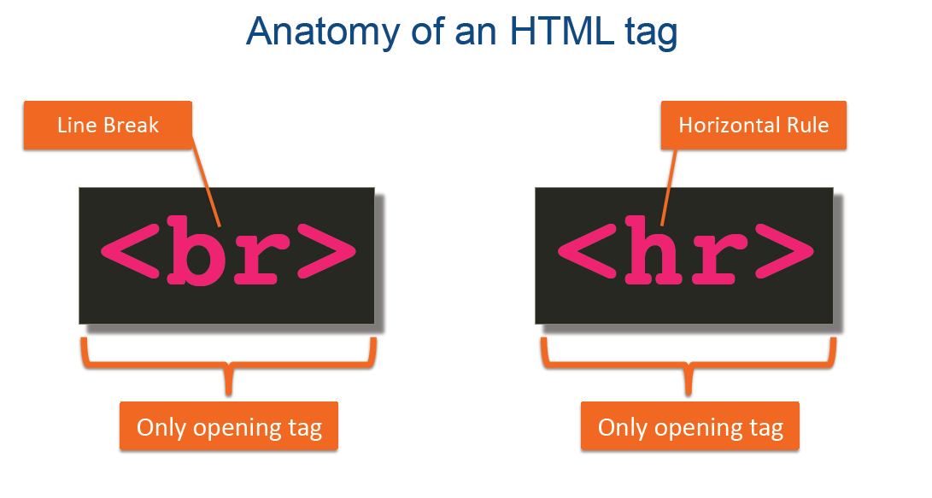

Slide 27
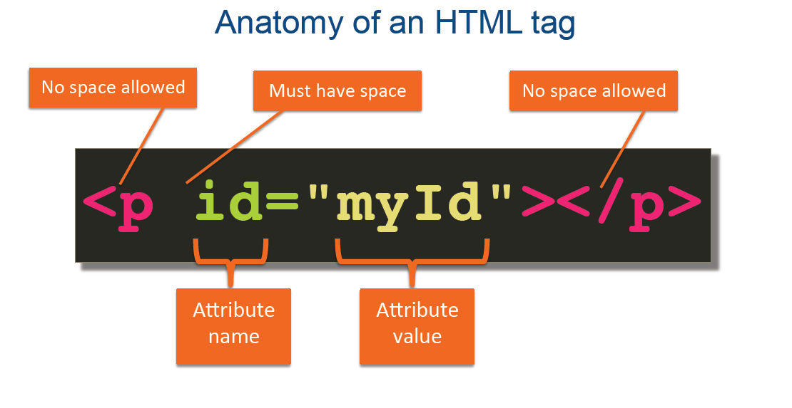

Slide 28
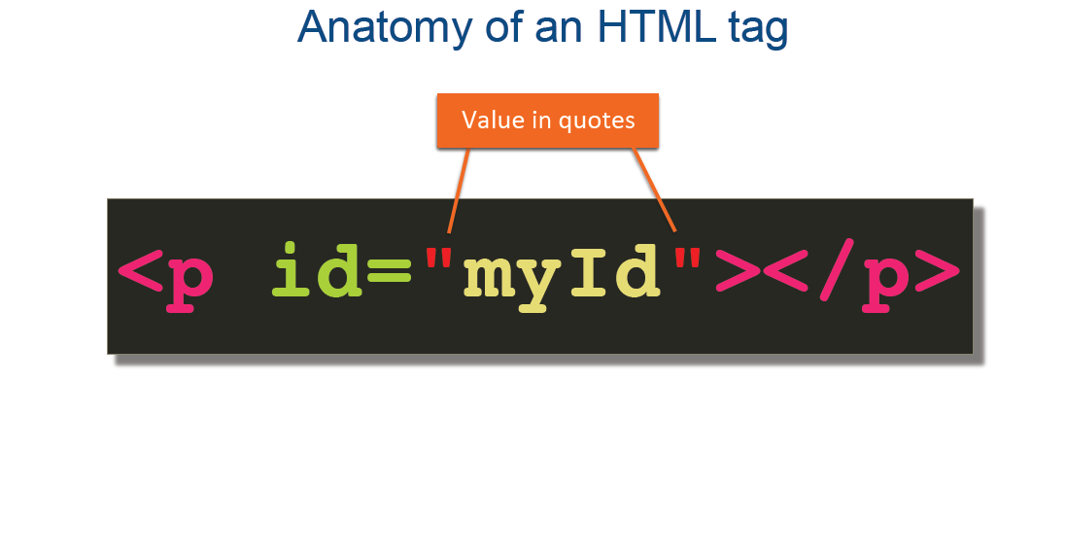

Slide 29
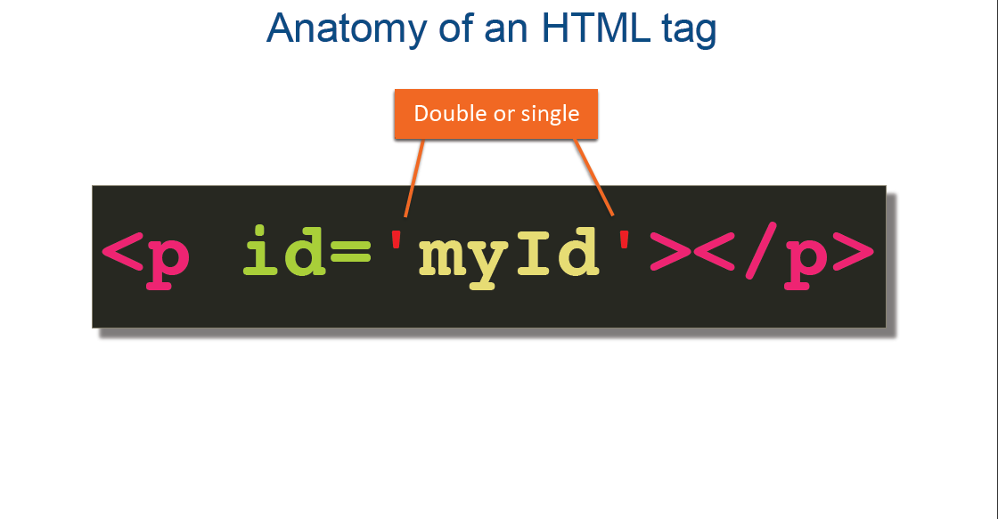

Slide 30
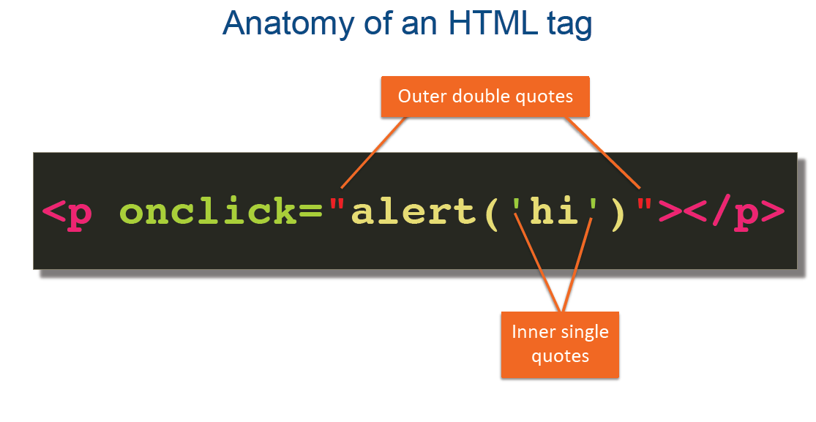

Slide 31
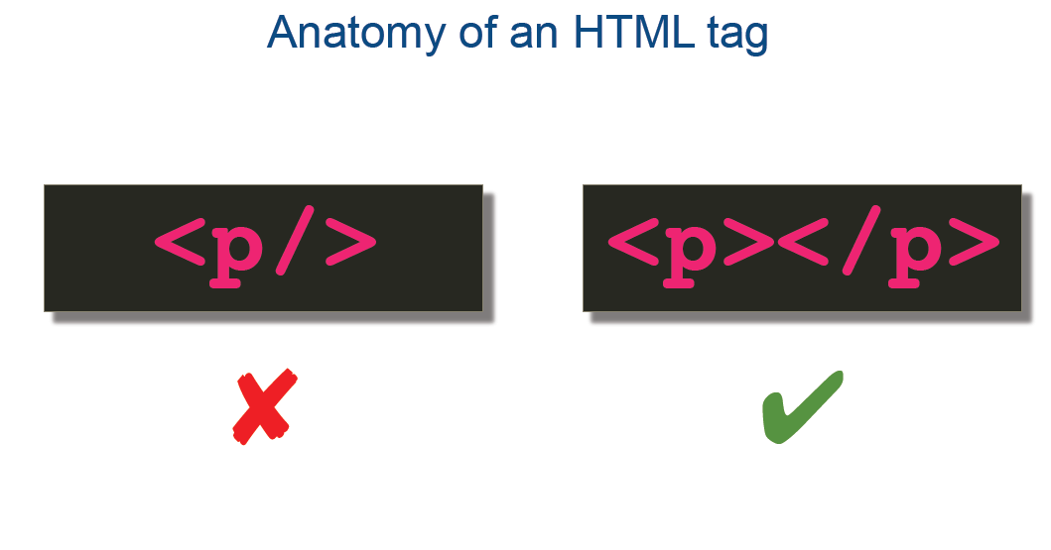

Slide 32
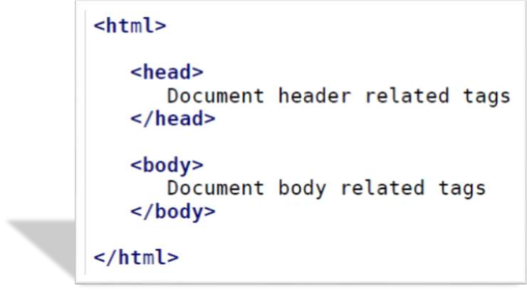
HTML Document Structure

Slide 33

HTML <!DOCTYPE> Declaration
<!DOCTYPE html>
<html>
<head>
<title>Title of the document</title>
</head>
1 to 7
<body>
The content of the document......
</body>
</html>
All HTML documents must start with a <!DOCTYPE> declaration.
In HTML 5, the declaration is simple:
<!DOCTYPE html>

Slide 34
HTML <!DOCTYPE> Declaration
The declaration is not an HTML tag.
The <!DOCTYPE> declaration tag is used by the web browser to understand the version of the HTML used in the document.
Current version of HTML is 5 and it makes use of the following declaration −
<!DOCTYPE html>

Slide 35
Browser Support
Older HTML Documents
In older documents (HTML 4 or XHTML), the declaration is more complicated because the declaration must refer to a DTD (Document Type Definition).
HTML 4.01:
<!DOCTYPE HTML PUBLIC "-//W3C//DTD HTML 4.01
Transitional//EN" "http://www.w3.org/TR/html4/loose.dtd">

Slide 36
<!DOCTYPE> declaration is NOT case sensitive.
Examples
<!DOCTYPE html>
<!DocType html>
<!Doctype html>
<!doctype html>
8
HTML <a> Tag
Example
Create a link to W3Schools.com:
<a href="https://www.w3schools.com">Visit W3Schools.com!</a>

Slide 37
HTML Versions
1. HTML 1.0 (1993)
Introduced by: Tim Berners-Lee.
Purpose: The first version of HTML, used for structuring and linking documents on the web.
Features: Very basic, with support for simple text, hyperlinks, and images.
2. HTML 2.0 (1995)
Standardized by: Internet Engineering Task Force (IETF).
Purpose: Provided a base standard for HTML usage.
Features:
Forms for user input.
Tables for data presentation.
Basic interactive elements.

Slide 38
3. HTML 3.2 (1997)
Standardized by: W3C (World Wide Web Consortium).
Purpose: Expanded HTML capabilities for more complex layouts and styling.
Features:
Tables for web layouts.
Inline styles via the style attribute.
Basic support for scripting with JavaScript.

Slide 39
4. HTML 4.01 (1999)
Standardized by: W3C.
Purpose: Enhanced structure and styling capabilities.
Variants:
Strict: Enforced stricter coding practices.
Transitional: Allowed older elements for backward compatibility.
Frameset: Added support for frames-based layouts.
Features:
Separation of content and presentation (encouraged use of CSS).
Support for more multimedia elements like <object>.

Slide 40
5. XHTML 1.0 (2000)
Based on: XML (Extensible Markup Language).
Purpose: A stricter and more XML-compliant version of HTML 4.01.
Features:
Enforced well-formed syntax (e.g., tags must close).
Compatibility with XML tools.

Slide 41
6. HTML5 (2014, finalized in 2017)
Standardized by: W3C and WHATWG (Web Hypertext Application Technology Working Group).
Purpose: Modernized HTML for multimedia, interactivity, and mobile-first web design.
Features:
New semantic tags like <header>, <footer>, <article>, and <section>.
Native support for audio (<audio>) and video (<video>) elements.
Canvas for 2D drawing and animations.
Improved form controls with new input types (e.g., date, email, range).
APIs for geolocation, local storage, and offline support.
No need for a DTD, simplified with <!DOCTYPE html>.

Slide 42
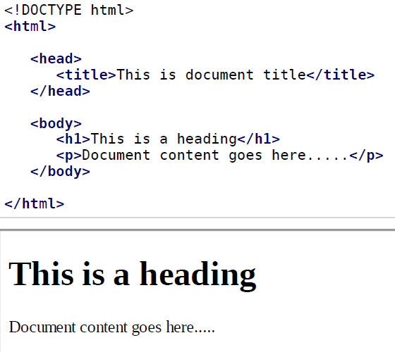
Basic HTML Document
Live Demo

Slide 43
Contents
HTML elements:
headings,
paragraphs,
line break,
colors & fonts,
links,
frames,
lists,
tables,
images and
forms,

Slide 44
HTML Basic Tags
Heading Tag
Heading tag is used to define heading in the HTML document.
HTML has six levels of heading tag, which are <h1>, <h2>, <h3>, <h4>, <h5> and <h6>.
Heading tags are used in any order within the HTML document.

Slide 45
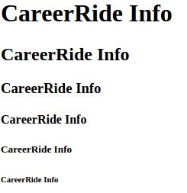
Example: Heading Tag
<!DOCTYPE html> <html> <head> <title>Example of Heading Tag</title> </head> <body> <h1>CareerRide Info</h1> <h2>CareerRide Info</h2> <h3>CareerRide Info</h3> <h4>CareerRide Info</h4> <h5>CareerRide Info</h5> <h6>CareerRide Info</h6> </body> </html>

Slide 46
Paragraph Tag
Paragraph tag is used to create paragraph.
In this, the end tag is omitted or is optional because whenever a new paragraph starts previous paragraph is already ended.
Syntax: <p>Write content here</p>

Slide 47
Eg: Paragraph Tag
<!DOCTYPE html> <html> <head> <title>Example of Paragraph Tag</title> </head> <body> <p>This is the first paragraph.........</p> <p>This is the second paragraph........ <p>This is the third paragraph........</p> </body> </html>
Output: This is the first paragraph......... This is the second paragraph........ This is the third paragraph........

Slide 48
Break Tag
Break tag is used to insert a line break.
It is an empty tag.
Syntax: <br> or <br/> or </br> Example: Break Tag
<!DOCTYPE html> <html> <head> <title>Example of Line-break Tag</title> </head> <body> <p>This tag is used to insert a line break.</br>It is empty tag.</p> </body> </html>
Output: This tag is used to insert a line break. It is empty tag.

Slide 49
Center Tag
Center tag is used to place the content in the center of a web page.
Syntax: <center>content</center>
<!DOCTYPE html> <html> <head> <title>Example of Center Tag</title> </head> <body> <center> <p>This is a paragraph.</p> </center> </body> </html>

Slide 50

Horizontal line Tag
This is used to draw a horizontal line on a web page.
The <hr> tag has no end tag.
Syntax: <hr> or <hr/>
Example: Horizontal line
<!DOCTYPE html> <html> <head> <title>Example of Horizontal line Tag</title> </head> <body> <p>This is a first paragraph.</p> <hr /> <p>This is a second paragraph.</p> </body> </html>

Slide 51
Div Tag
The <div> tag defines a division or a section in an HTML document.
The <div> tag is used to group block-elements to format them with CSS.
The <div> element is very often used together with CSS, to layout a web page.

Slide 52
Attributes
Attributes provide additional information about HTML elements.
All HTML elements can have attributes.
Attributes are always specified in the start tag.
Attributes usually come in name/value pairs like: name=“value”.

Slide 53
Attributes
Core attributes are
id
title
class
style
lang
dir

Slide 54
Attributes
Id
The id attribute of an HTML element provides a unique identifier for an element within the document.
The id value is case sensitive.
Syntax: <element id=“value”>
Example: <div id=“mnu”>
Title
The title attribute specifies extra information about an element.
The information is displayed in a tooltip when the mouse pointer is placed over the element.
Syntax: <element title=“text”> Example: <h1 title=“about JavaScript”>JavaScript</h1>

Slide 55
Attributes
class
The class attribute is used to specify the class of element.
This attribute is used to associate an element with a style sheet.
One or more class names can be specified for an element.
Syntax: <element class="classname">
Example: <div class="applycolor">Welcome to CareerRide Info</div>

Slide 56
Eg: Class Attribute
<body>
<h1 class="intro">Header 1</h1>
<p>A paragraph.</p>
<p class="important">Note that this is an important paragraph.</p>
</body>
</html>
<!DOCTYPE html>
<html>
<head>
<style>
h1.intro {
color: blue;
}
p.important {
color: green;
}
</style>
</head>

Slide 57
Attributes
Core attributes are
id
title
class
style
lang
dir

Slide 58
Attributes
Style
The style attribute specifies an inline style for the element.
This attribute provides the facility to specify Cascading Style Sheet (CSS) rules within the element.
Syntax:
<tagname style="property:value;">
Example: <p style="font-family:arial; color:#800080; text-align:center">CareerRide Info</p>

Slide 59
Eg: Style Attribute
I am normal
I am red
I am blue
I am big
<html>
<body>
<p>I am normal</p>
<p style="color:red;">I am red</p>
<p style="color:blue;">I am blue</p>
<p style="font-size:36px;">I am big</p>
</body>
</html>

Slide 60
Attributes
Core attributes are
id
title
class
style
lang
dir

Slide 61
Attributes
Lang
The lang attribute specifies the language of the element’s content
The lang attribute can be used on any HTML element.
Syntax: <element lang=“language_code”>
Example: <html lang="en">
“en" for English, "es" for Spanish, "fr" for France and so on.

Slide 62
Eg: Lang Attribute
<html>
<body>
<p>This is a paragraph.</p>
<p lang="fr">Ceci est un paragraphe.</p>
</body>
</html>

Slide 63
Attributes
Core attributes are
id
title
class
style
lang
dir

Slide 64
Attributes
dir
The dir attribute specifies the reading direction for text as left to right or right to left.
Syntax: <element dir="ltr"> Example: <p dir="rtl"> content </p>
Value | Meaning
ltr | Left to right direction
rtl | Right to left direction

Slide 65
Text Formatting Tags
Tag | Description | Example and Output
Bold | It defines bold text. | Example: <b>CareerRide Info</b> Output: CareerRide Info
Italic | It defines italic text. | Example: <i>TutorialRide.com</i> Output: TutorialRide.com
Underline | It underlines the text. | Example: <u>TutorialRide.com</u> Output: TutorialRide.com
Strike-out | It puts a line right through the center of the text, crossing it out. It shows that the text is old and no longer relevant. | Example: <strike>ABC Coperation</strike> Output: ABC Coperation

Slide 66
Text Formatting Tags
Tag | Description | Example and Output
Small | It defines small text. | Example: <h4>CareerRide <small>Info</small></h4> Output:CareerRide Info
Font Color | It changes the text color. | Example: <font color=“#000fff”>TutorialRide.com</font> Output: TutorialRide.com
Emphasis | It is used to emphasize text, usually it appears in italics but can vary according to your browser. | Example: <em>CareerRide Info</em> Output: CareerRide Info
Mark | It defines marked or highlighted text. | Example: <mark>TutorialRide.com</mark> Output: TutorialRide.com

Slide 67
Text Formatting Tags
Tag | Description | Example and Output
Subscript | It defines subscripted text. | Example: H<sub>2</sub>O Output: H₂O
Superscipt | It defines superscripted text. | Example: E = mc<sup>2</sup> Output: E = mc²
Strong | It defines strong text. Usually it appears in bold but can vary according to your browser. | Example: <strong>CareerRide Info</strong> Output: CareerRide Info

Slide 68
HTML Color and Font Tags
Colors and Fonts
Colors
Attributes of <body> tag
bgcolor
Used to set background color of the page
text
Used to set color to the body (text attribute not supported in HTML5)
alink
Used to set color to the active links or selected links
link
Used to set color to the linked text
vlink
Used to set the color to the visited links i.e for linked text that you have already clicked on

Slide 69
DEMO1.HTML

Slide 70
HTML Table eg
The <table> tag is used to define a table.
Table rows are created by using <tr> tag.
Table rows are divided into table data by using <td> tag.
The <th> tag is used to create table column heading or row heading.
Table Attributes
Table border
Background color
Table border color

Slide 71
HTML Table eg
<html>
<table border=2 bordercolor="red" bgcolor="blue" align="center" style= "color:yellow">
<th>rollno.</th>
<th>Name</th>
<th>class</th>
</tr>
<tr>
<td>1</td>
<td>xy</td>
<td>te2</td>
</tr>
</table>
</html>

Slide 72
HTML Table
Rowspan and Colspan Attribute
Rowspan: This attribute is used to combine two or more rows into a single cell.
Colspan: This attribute is used to combine two or more columns into a single cell.

Slide 73
HTML Table
<html>
<table border=2 width="50">
<tr>
<td rowspan="2">1 </td>
<td>2</td>
</tr>
<tr><td>3</td>
</tr>
<tr>
<td>4</td>
<td>5</td>
</tr>
</table>
</html>
1 | 2
 | 3
4 | 5

Slide 74
HTML Table
1 | 2
3
4 | 5
1 |  | 2
3 | 4
5 |  | 6

Slide 75
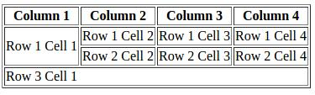
HTML Table eg +

Slide 76
HTML Table
Output:
Cellspacing and Cellpadding Attributes
Cell spacing: Cell spacing specifies the distance between the edges of the table cells.
Cell padding: Cell padding specifies the distance between the edges of the table cells and their content.

Slide 77
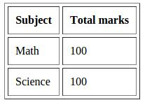
HTML Table eg
<table border="1" cellpadding="10" cellspacing="5">
<tr>
<th>Subject</th>
<th>Total marks</th>
</tr>
<tr>
<td>Math</td>
<td>100</td>
</tr>
<tr>
<td>Science</td>
<td>100</td>
</tr>
</table>

Slide 78
HTML Table eg
Width and Height Attributes
Width and height attributes are used to set table width and height.
Values are given in pixels.
Table Caption
The <caption> tag is used to give heading to the whole table.
This tag is always placed after <table> and before first <tr> tag.

Slide 79
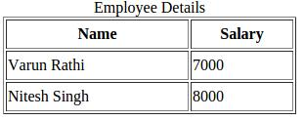
HTML Table eg
<table border="1" width="300" height="100" >
<caption>Employee Details</caption>
<tr>
<th>Name</th>
<th>Salary</th>
</tr>
<tr>
<td>Varun Rathi</td>
<td>7000</td>
</tr>
<tr>
<td>Nitesh Singh</td>
<td>8000</td>
</tr>
</table>

Slide 80
Attribute of Table tag
TAG | Value | Description
align | Left , center , right | Specifies the alignment of a table.
bgcolor | rgb(x,x,x) , #xxxxxx, colopname | Specifies the color for background
border | Any number | Specifies the size of border
cellpadding | Pixels | Specifies the space between cell wall and the cell content
Cellspacing | Pixels | Specifies the space between cells
Width | Pixels % | Specifies the width of table
Height | Pixels % | Specifies the height of table
Bordercolor | rgb(x,x,x) , #xxxxxx, colopname | Color of table border

Slide 81
HTML List
Output:
Lists are used to represent group of items.
They must contain one or more list elements.
HTML supports three types of lists –
Ordered list,
Unordered list and
Definition list.

Slide 82
HTML List eg
Ordered list
Ordered list is the collection of related items which has special order or sequence.
This list is numbered.
The ordered list is created by using <ol> tag.
Syntax: <ol> <li>text</li> </ol>
Eg:
<ol> <li>Maths</li> <li>Physics</li>
</ol>
Output:
1. Maths
2. Physics

Slide 83
HTML List Attribute +
Attributes | Description | Example and Output
type | Used to specify type of numbering like 1/a/A/I/i. Default type is ‘1’. | Example: <ol type="a"> <li>Maths</li> <li>Physics</li> </ol> Output: a. Maths b. Physics
start | Using this attribute any value can be set as the starting position. | Example: <ol type="i" start="4"> <li>Maths</li> <li>Physics</li> </ol> Output: iv. Maths v. Physics

Slide 84
HTML List Attribute eg +
Attributes | Description | Example and Output
value | Using this attribute the numbering sequence can be changed in the middle of an ordered list. It is to be specified with the <li> tag. | Example: <ol> <li type="a" value="3">Maths</li> <li value="5">Physics</li> </ol> Output: c. Maths 5. Physics

Slide 85
HTML List eg
Unordered list:
Unordered list is nothing but the collection of related items which has no special order or sequence.
The list item in the list is indicated by bullet.
Syntax: <ul><li>text</li></ul>
Eg:
<ul> <li>Maths</li> <li>Physics</li>
</ul>
Output:
Maths
Physics

Slide 86
HTML List Attribute
Attribute | Description | Example and Output
type | Used to specify type of list item like bullet, circle and square. Default type is bullet. | Example: <ul type="square"> <li>Maths</li> <li>Physics</li> </ul> Output: Maths Physics

Slide 87
HTML List eg
Definition list:
Definition list has two parts, first is definition term and second is actual definition.
The <dl> tag is used to create definition list.
The <dl> tag encloses <dt> and <dd> tags which are used for definition term and actual definition respectively.
Syntax: <dl> <dt>Definition Term</dt> <dd>Definition</dd> </dl>
<dl>
<dt><b>jQuery</b></dt>
<dd>jQuery is a JavaScript Library.</dd>
<dt><b>AngularJS</b></dt>
<dd>AngularJS is a JavaScript framework.</dd>
</dl>

Slide 88
HTML Image eg
img tag is used to insert image in web page.
It is an empty tag, means it does not have end tag.
Syntax: <img src="url" alt="some_text"> Example:
<img src=“desert.jpg" width="200" height="100" alt=“desert" valign=“top“ align=“left”>
<img src="Desert.jpg" style="float:left;width:50px;height:60px;" alt="desert"> The image will float to the right of the text</p>
<img src="Desert.jpg" style="width:50px;height:60px;" alt="desert" align="right">

Slide 89
Attributes of Image Tag
Attribute | Value | Description
align | Top bottom left middle right | Specifies the alignment of an image
alt | Text | Defines an alternate text for the image
border | Pixels | Defines the width of the border around an image
height | Pixels | Defines the height of the image
hspace | Pixels | Defines the whitesapce on both of the left and right side of an image
vspace | Pixels | Defines the whitesapce on top and bottom of an image
src | URL | Defines the URL of an image
width | Pixels | Defines the width of the image

Slide 90
HTML Frames
Frames :
Usually we can display only one web page at a time in the browser window.
to display multiple pages at a the same time on the browser window
A group of frames in the window is called frameset.
In the frameset application the basic tag of html like <body> is not used.
<frameset> tag is used.
2 main attributes of <frameset>tag are:
Rows : Define the horizontal frames.
Cols : Define the vertical frames.

Slide 91
HTML Frames eg
<frameset> tag :
<frame> is the sub-tag of frameset. The <frame> tag has attribute “src” which we have to
specify the URL of the web page which we want to display in particular frame.
Attributes of <frameset>
Cols : Specifies the number of columns contained in the frameset and also size of all the
columns. We can set cols = “200, 400, 100” or cols = “20%, 70%, 10%” or cols = “20%, *, 20%.
Rows : horizontal frames.
Rows = “20%, 80%” : It will generate two horizontal frames
Attributes of <frameset>
border : width of the border. For eg : border=“3”.
Frameborder : this attributes mentions whether to display a three dimensional border between frames or not. It takes value 1 (true) or 0 (false). For eg: frameborder = “1” specifies frame with three dimensional border.

Slide 92
HTML Frame eg +
<frameset> tag Collection of frames is called as frameset.
When using frames on a page then use <frameset> tag instead of <body> tag.
The rows attribute of <frameset> tag indicates horizontal frames and cols attribute indicates vertical frames.
Syntax:<frameset>...........</frameset>
<frame> tag<frame> tag is used to define a frame within a <frameset> tag.
A frame should be used within a <frameset> tag.
Syntax:<frame src=”frm1.htm”>

Slide 93
HTML Frame eg +
<frameset cols="50%,50%"> <frame src="http://www.careerride.com/test-login.aspx" > <frame src="http://careerride.com/" > </frameset>

Slide 94
Target Attribute in HTML Frame eg
Frame_target.html
<frameset cols="20%,40%,40%">
<frame src="frame3.html" name="f1">
<frame name="f2" >
<frame name="f3" >
</frameset>

Slide 95
Target attribute in HTML Frame eg +
Output:
Frame3.html
<html>
<body>
<a href="table.html" target="f2" >SE</a>
<a href="table_span.html" target=“f3">TE</a>
</body>

Slide 96
HTML Frame eg +
<frameset> Tag Attributes:
Attributes | Description
cols (Columns) | It specifies how many columns are to be contained in the frameset and the size of each column.
rows | It is used to specify the number of rows in the frameset.
border | It specifies the width of the border of each frame in pixels. For example; border = “5”. A value of zero means no border.
framespacing | It specifies the amount of space between frames in a frameset. It can take any integer value. For example; frame spacing = “10” means there should be 10 pixels spacing between each frame.

Slide 97
HTML Form
Form is a part of web page.
It is used to collect user input through elements like
text fields, check box and radio button, select option, text area, submit buttons
Form works like a container which consists of controls known as form elements.
The HTML <form> tag is used to create an HTML form.
Syntax: <form action="Script URL" method="GET/POST"> form elements land layout tags </form>

Slide 98
HTML Form
Attribute | Description
action | Specifies the encoding of the submitted data.
method | Specify the method to be used to upload data.
name | Used to identify and retrieve values from each form on the web page.
target | Indicates the target of the address in the action attribute.
<form action="/action_page.php">

Slide 99
HTML Form eg
Output:
Creating text box
The <input> tag is used to create form elements.
It does not have end tag.
Attributes of <input> tag
Attribute | Description
Type | Specifies the type of input control.
Name | Used to give a name to the control.
Id | Used to identify the input field uniquely.
Size | Used to specify the width of the text-input control in terms of characters
Value | It is a default text or number that is displayed in the text field.
Maxlength | Used to specify the maximum number of characters a user can enter into a input field.

Slide 100
HTML Form eg +
Output:
Creating text box
<html>
<body>
<form>
<b>name</b><input type=“text” size=“20” value=“ “ maxlength=“4”>
</form>
</body>
</html>

Slide 101
HTML Form eg
Output:
Creating password A password field is nothing but the text box in which the characters typed by the user are displayed as bullet or asterisks.
Creating Submit Button Submit button is used to send the form's data to the specified URL.
Creating Radio Button Radio button is used to select a single option from the list of options.

Slide 102
HTML Form eg
Creating Check Box Check box is used to select more than one option from the list of options.
Creating Multiple-Line Text Input The <textarea> tag is used to create multi-line text box.
This is used to enter large amount of data.
Creating Menu
<select> tag is used to create popdown menu

Slide 103
HTML Form eg +
<body>
<form >
Name: <input type="text" name="name" />
<br>
Mobile No: <input type="text" name="mob_no" />
<br>
Password: <input type="password" name="password" />
<br>
<input type="submit" value="Submit">
<br>
<input type="radio" name="gender" value="male" > Male
</br>

Slide 104
HTML Form eg
<input type="radio" name="gender" value="female" > Female
<br>
<input type="checkbox" name="c1" value="cricket" checked="checked"> Cricket
</br>
<input type="checkbox" name="c2" value="hockey" > Hockey
<br>
<textarea rows="4" cols="30" name="address">
Text Area.....
</textarea>
</form>

Slide 105
HTML Form eg
City:
<select name="menu">
<option value="Aurangabad">Aurangabad</option>
<option selected value="Mumbai">Mumbai</option>
<option value="Pune">Pune</option>
</select>
<br>
<input type="submit" value="Submit">
</form>

Slide 106
HTML 5.0 eg
Objective:
Support for latest multimedia
Include elements as <video>, <audio> and <canvas> to draw graphics elements.
Features :
Support for multimedia elements such as <audio> and <video>
Support for <header>,<footer>, <article> and
<section>
New form cntrl such as number , date , time, calendar and range.

Slide 107
HTML 5.0 eg
<video width="320" height=240" controls>
<source src="Video1.mp4" type="video/mp4">
Your browser does not support the video tag.</video>
<br><canvas id="myCanvas">Your browser does not support the HTML5 canvas tag.</canvas>
<script>
var c =document.getElementById("myCanvas");
var ctx = c.getContext("2d");
ctx.fillStyle = "#FF0000";
ctx.fillRect(0, 0, 80, 100);
</script></body></html>
<html>
<body>
Quantity (between 1 and 5): <input type="number" name="quantity" min="1" max="5"><br>
<input type="date" name="bday"><br>
Enter a date after 1980-01-01:
<input type="date" name="bday" min="1979-12-31"><br>
Enter a date before 2000-01-01:
<input type="date" name="bday" max="2000-01-02"><br>
E-mail:
<input type="email" name="email"><br>
<input type="range" name="points" min="0" max="10"><br>
<audio controls>
<source src="glossy.mp3" type="audio/ogg"> Your browser does not support the audio element.
</audio><br><br>

Slide 108
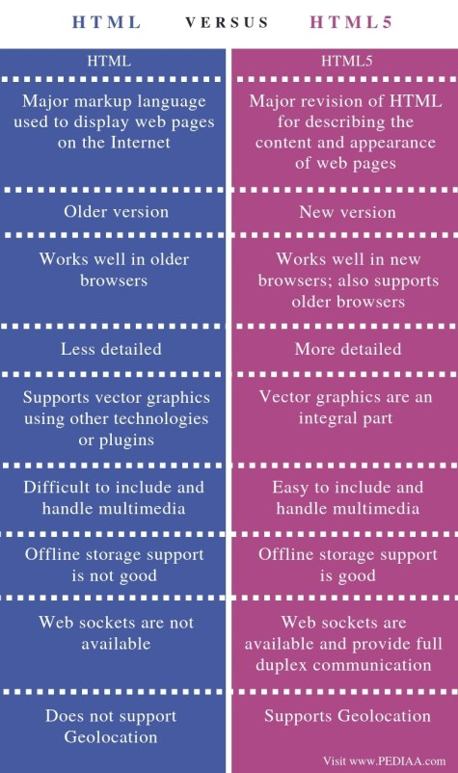
HTML
vs HTML5

Slide 109
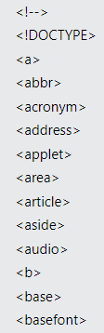
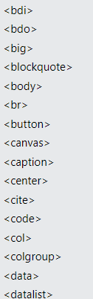
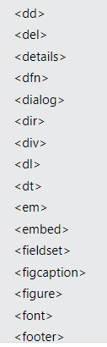
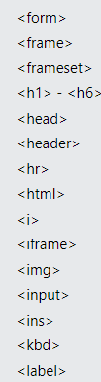
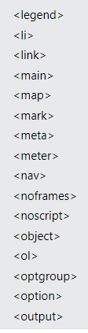
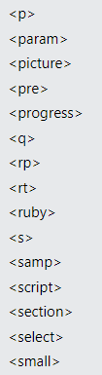
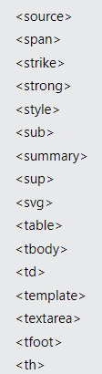
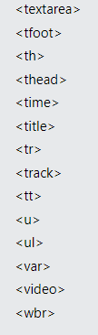
HTML Tags

Slide 110
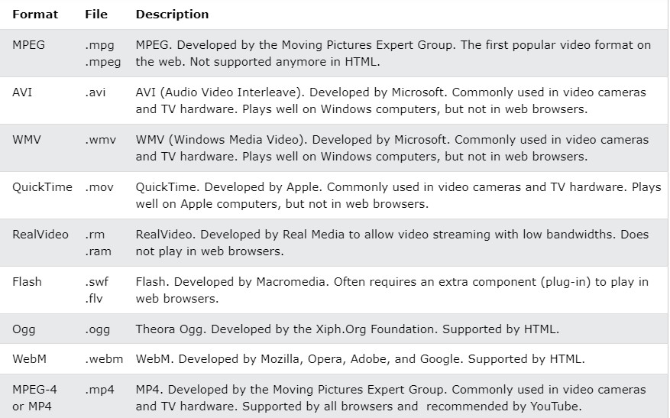
HTML Media

Slide 111
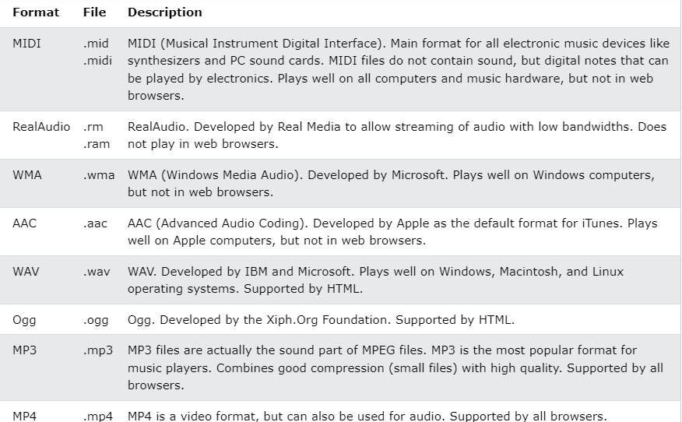
Common Audio Formats

Slide 112
HTML Video
To show a video in HTML, use the <video> element:
<video width="320" height="240" controls>
<source src="movie.mp4" type="video/mp4">
<source src="movie.ogg" type="video/ogg">
Your browser does not support the video tag.
</video>

Slide 113
Reference
https://www.w3schools.com/html/default.asp

Slide 114
CSS

Slide 115
CSS
Why CSS
Types of CSS
How to use CSS
Properties
Classes, Child-Class (Nested CSS)
Colors, Text, Background, Border, Margin, Padding
Positioning (flex, grid, inline, block), Animation, Transition

Slide 116
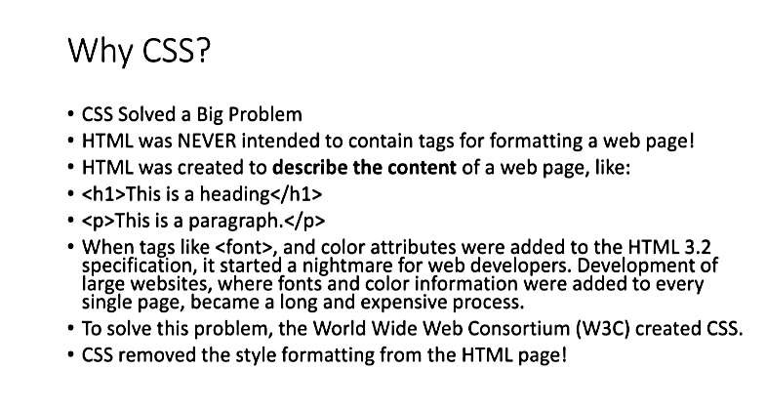

Slide 117
<p>
<font face="Arial">Shashdot.</font>
News for <b>nerds!!</b> You will <i>never</i>, <u>EVER</u>
be
<font size="+4" color="red">BORED</font> here!
</p> HTML
Slashdot. News for nerds!! You will never, EVER be BORED
here!
output
Tags such as b, i, u, and font are discouraged in strict XHTML
Why is this bad?
CS380
57

Slide 118
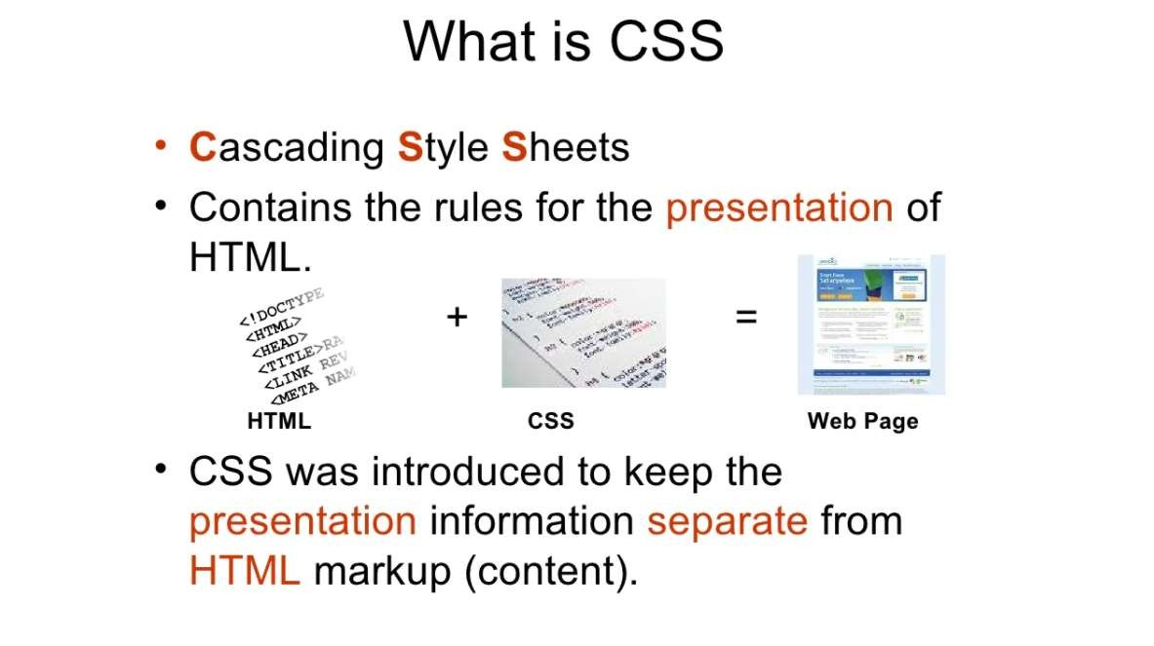

Slide 119
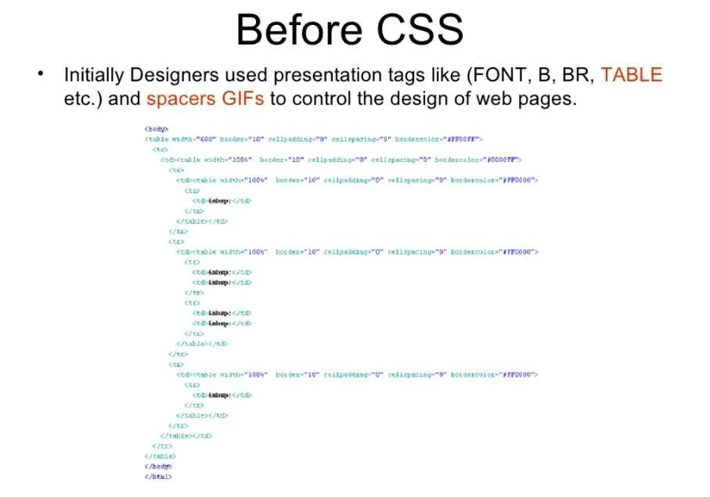

Slide 120
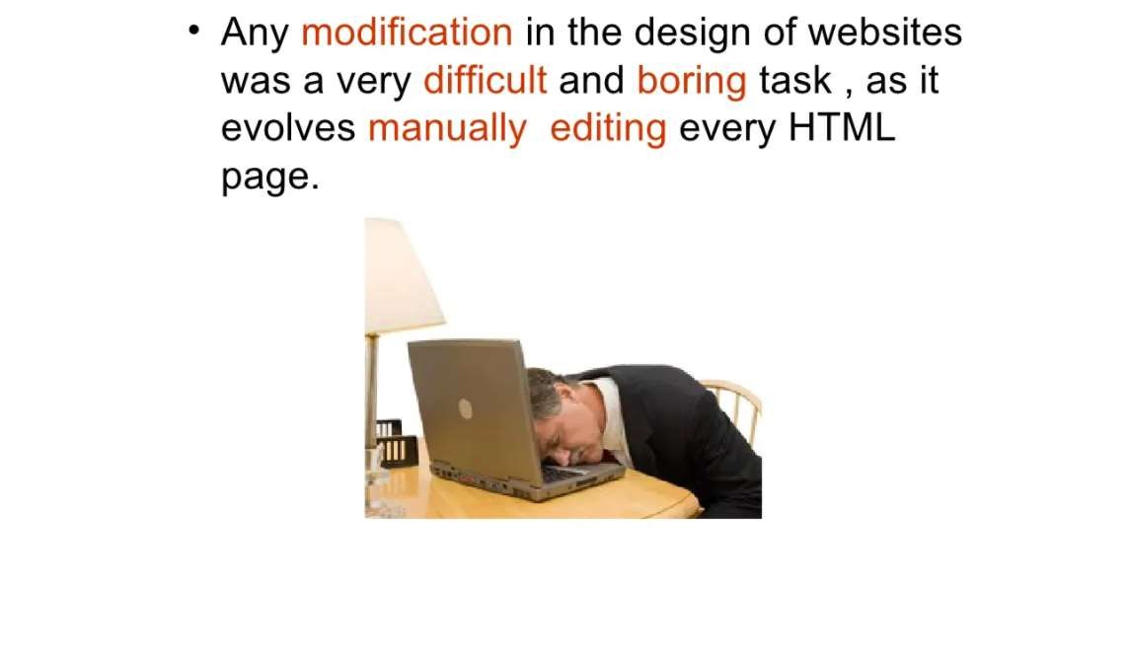

Slide 121
Cascading Style-Sheet(CSS)
Introduction to Style Sheet
CSS is a language that describes the style of an HTML document.
CSS describes how HTML elements should be displayed.
The separation of HTML from CSS makes it easier to maintain sites, share style sheets across pages, and tailor pages to different environments.
This is referred to as the separation of structure (or: content) from presentation.

Slide 122
Advantages of using CSS
flexibility can be achieved.
Separate the actual content from the style, helps in managing large-scale complex sites.

Slide 123
Cascading Style-Sheet(CSS)
Inserting CSS in an HTML page
Inline style sheet
Document level style sheet
External level style sheet
CSS selectors
CSS selectors define the elements to which a set of CSS rules apply.

Slide 124
Cascading Style-Sheet(CSS) eg
Inline style sheet
syntax
< tag style=“property: value” >
Eg:
<p style= “font-size:40pt;color:#abcdef">web technoloy</p>

Slide 125
Style Attribute eg
I am normal
I am red
I am blue
I am big
<html>
<body>
<p>I am normal</p>
<p style="color:red;">I am red</p>
<p style="color:blue;">I am blue</p>
<p style="font-size:36px;">I am big</p>
</body>
</html>

Slide 126
Cascading Style-Sheet(CSS) eg
Document level style sheet
Appears only in <head> section
Mention doc type
Eg. <style type=“text/css”>

Slide 127
Cascading Style-Sheet(CSS) eg
<html>
<head>
<style type="text/css">
h1
{
font-family:Arial;
color:red
}
h2
{
font-family:Arial;
color:green;left:20px
}
p
{
font-family:Arial;
color:blue;left:40px;font-size:24pt
}
</style>
</head>
<body>
<h1>web technoloy1</h1>
<h2>web technoloy2</h2>
<p>web technoloy<p/>
</body>
</html>

Slide 128
Cascading Style-Sheet(CSS) eg
External level style sheet
Desired style sheet is stored in one .css file.
Mention name of the .css file in .html file
Use of ESS is to apply particular style to more than one web documents.

Slide 129
Cascading Style-Sheet(CSS) eg
Ext_css1.css
h1
{
font-family:Arial;
color:red;
}
p
{
font-family:Arial;
color:blue;
}

Slide 130
Cascading Style-Sheet(CSS) eg
ext_css.html
<html>
<head>
<link rel="stylesheet" type="text/css" href="ext_css1.css">
</head>
<body>
<h1>heading1</h1>
<p>pict</p>
</body>
</html>

Slide 131
CSS Selector eg
CSS selectors are used to select the content you want to style.
Selectors are the part of CSS rule set.
CSS selectors select HTML elements according to its id, class, type, attribute etc.
Types of CSS Selectors
CSS Element Selector
CSS Id Selector
CSS Class Selector
CSS Universal Selector
CSS Group Selector

Slide 132
CSS Element Selector eg
The element selector selects the HTML element by name.
<html>
<head>
<style type="text/css">
h1
{
font-family:Arial;
color:red
}
h2
{
font-family:Arial;
color:green;left:20px
}
</style>
</head>
<body>
<h1>web technoloy1</h1>
<h2>web technoloy2</h2>
<p>web technology<p/>
</body>
</html>

Slide 133
CSS ID Selector eg
Selects the id attribute of an HTML element to select a specific element.
An id is always unique within the page so it is chosen to select a single, unique element.
It is written with the hash character (#), followed by the id of the element.
</style>
</head>
<body>
<p id=top>web technoloy1</p>
<p >web technoloy2</p>
</body>
</html>
<html>
<head>
<style type="text/css">
#top
{
font-family:Arial;
color:red;
font-size:20pt;
}

Slide 134
CSS Class Selector eg
The class selector selects HTML elements with a specific class attribute.
It is used with a period character . (full stop symbol) followed by the class name.
<html> <head>
<style type="text/css">
.size20
{
font-family: Arial;
color:red;
font-size:20pt;
}
.size30
{
font-family:Arial;color:green;
Font-size:30pt; }
</style>
</head>
<body>
<p class="size20">web technoloy1</p>
<p class="size30">web technoloy2</p>
<h1 class="size30">HTML</h1>
<p>web technoloy<p/>
</body>
</html>

Slide 135
CSS Class Selector for Specific Element eg
Only one specific HTML element should be affected then use the element name with class selector.
<html>
<head>
<style>
p.center {
text-align: center; color: blue; }
</style>
</head>
<body>
<h1 class="center">This heading is not affected
</h1>
<p class="center">This paragraph is blue and center-aligned.
</p>
</body>
</html>

Slide 136
CSS Selector eg
Universal Selectors
Denoted by *, can be applied to all the element in the document.
<html>
<head>
<style type="text/css">
*{
font-family:Arial;
color:red;
font-size:20pt;
}
</style>
</head>
<body>
<h1 >web technoloy1</h1>
<h2 >web technoloy2</h2>
<P>html</p>
</body>
</html>

Slide 137
CSS Selector eg
Group Selector
To select all the elements with the same style definitions.
Grouping selector is used to minimize the code.
Commas are used to separate each selector in grouping.
<html>
<head>
<style>
h1, h2, p {
text-align: center;
color: blue;
}
</style>
</head>
<body>
<h1>Hello Javatpoint.com</h1>
<h2>Hello Javatpoint.com (In smaller font)</h2>
<p>This is a paragraph.</p>
</body>
</html>

Slide 138
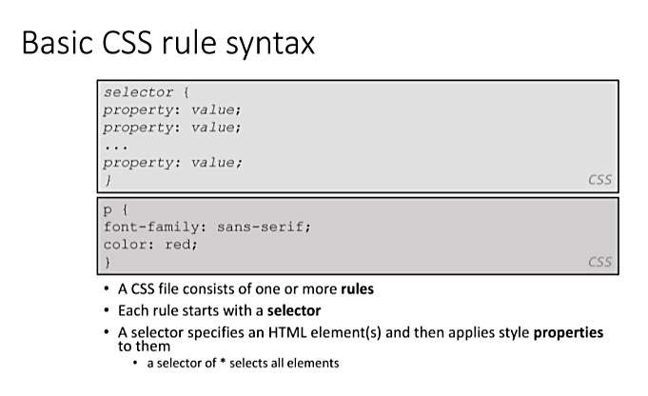

Slide 139
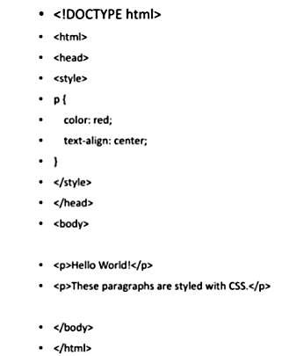

Slide 140
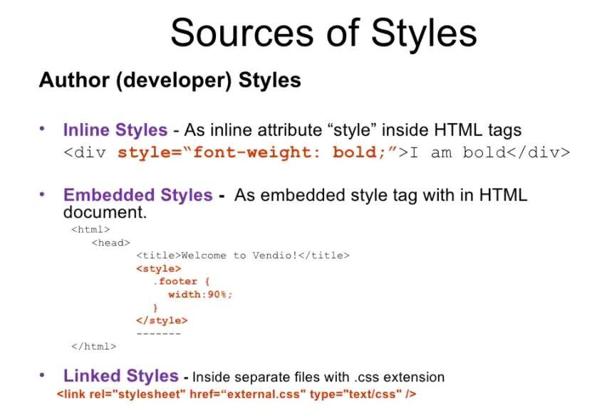

Slide 141
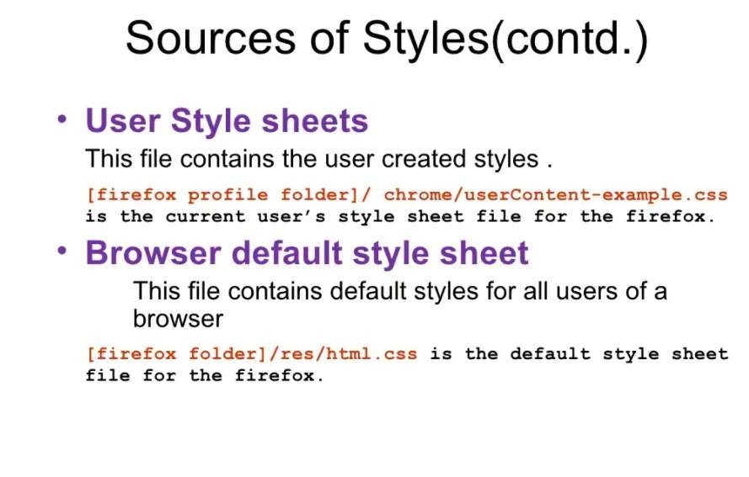

Slide 142
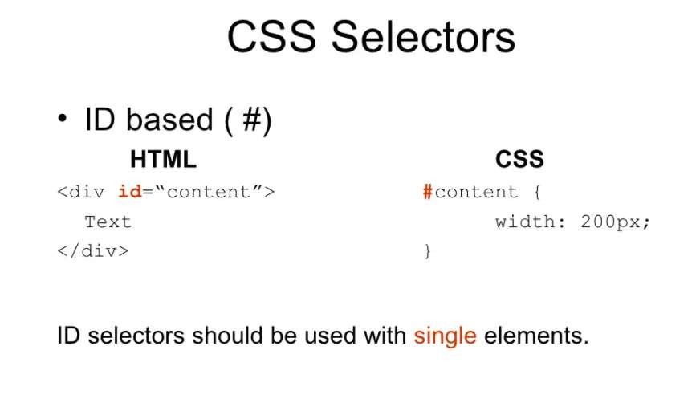

Slide 143
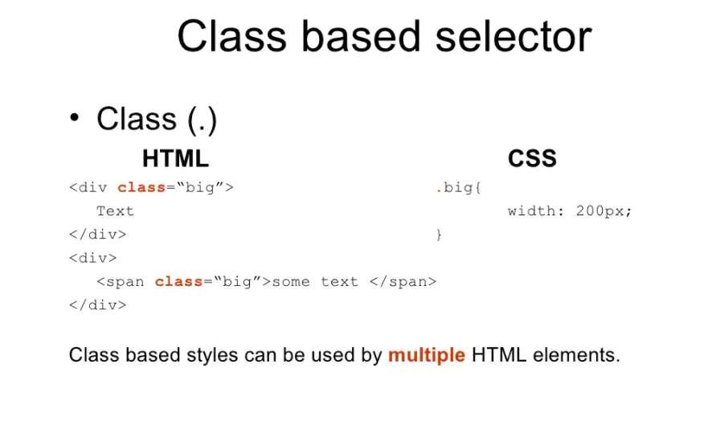

Slide 144
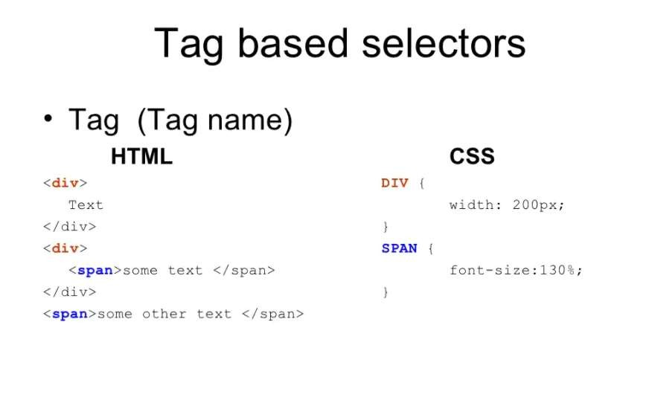

Slide 145
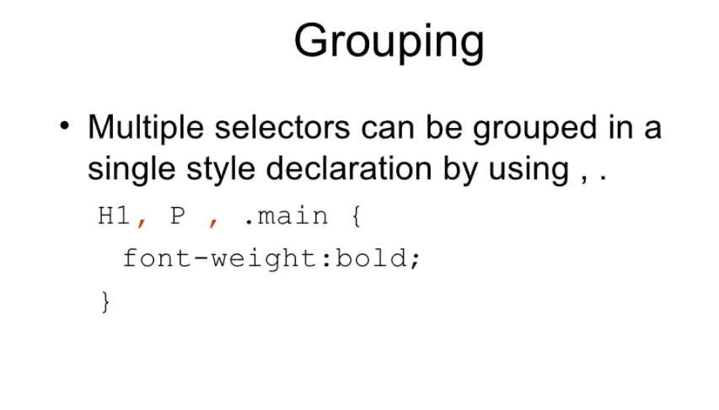

Slide 146
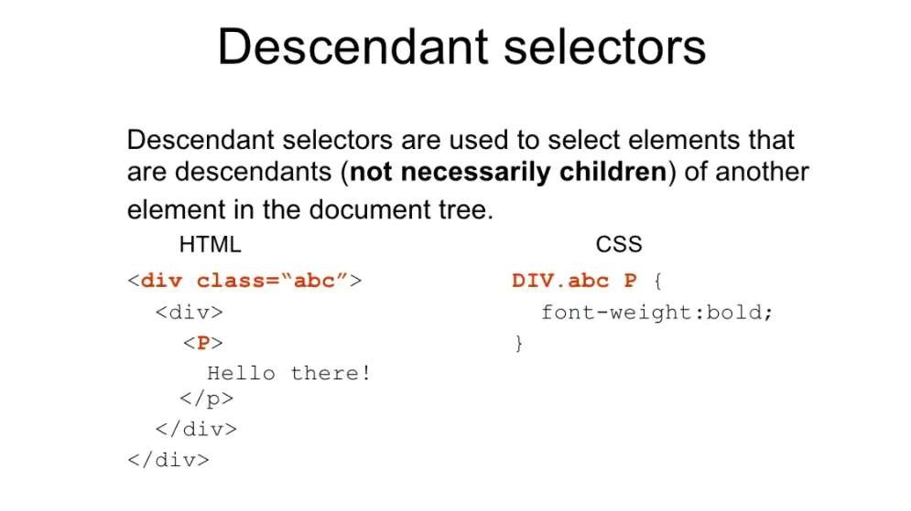

Slide 147
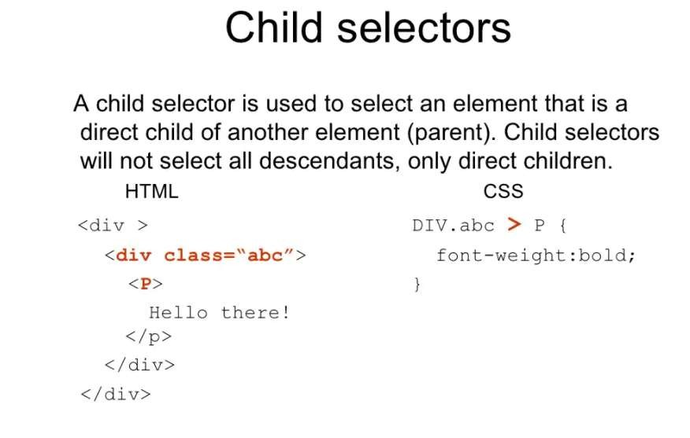

Slide 148
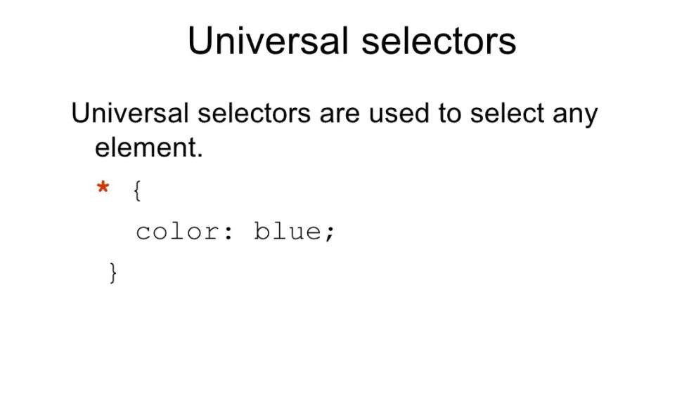

Slide 149
Basic CSS rule syntax
selector { property: value; property: value;
...
property: value;
}
CSS
p {
font-family: sans-serif;
color: red;
}
CSS
A CSS file consists of one or more rules
Each rule starts with a selector
A selector specifies an HTML element(s) and then applies style properties
to them
a selector of * selects all elements
72

Slide 150
Attaching a CSS file <link>
<head>
...
<link href="filename" type="text/css" rel="stylesheet" />
...
</head> HTML
<link href="style.css" type="text/css" rel="stylesheet" />
<link href="http://www.google.com/uds/css/gsearch.css"
rel="stylesheet" type="text/css" />
HTML
A page can link to multiple style sheet files
In case of a conflict (two sheets define a style for the same HTML element), the latter sheet's properties will be used
CS380
150

Slide 151
Embedding style sheets: <style>
<head>
<style type="text/css">
p { font-family: sans-serif; color: red; }
h2 { background-color: yellow; }
</style>
</head>
HTML
CSS code can be embedded within the head of an HTML page
Bad style and should be avoided when possible (why?)
CS380
151

Slide 152
Inline styles: the style attribute
<p style="font-family: sans-serif; color: red;">
This is a paragraph</p>
HTML
This is a paragraph
output
Higher precedence than embedded or linked styles
Used for one-time overrides and styling a particular element
Bad style and should be avoided when possible (why?)
CS380
152

Slide 153
CSS properties for colors
p {
color: red;
background-color: yellow;
}
CSS
This paragraph uses the style above output
property | description
color | color of the element's text
background-color | color that will appear behind the element
CS380
153

Slide 154
Specifying colors
p { color: red; }
h2 { color: rgb(128, 0, 196); }
h4 { color: #FF8800; }
CSS
This paragraph uses the first style above
This h2 uses the second style above.
This h4 uses the third style above.
output
color names: aqua, black, blue, fuchsia, gray, green, lime, maroon, navy,
olive, purple, red, silver, teal, white (white), yellow
RGB codes: red, green, and blue values from 0 (none) to 255 (full)
hex codes: RGB values in base-16 from 00 (0, none) to FF (255, full)
77

Slide 155
Grouping styles
p, h1, h2 {
color: green;
}
h2 {
background-color: yellow;
}
CSS
This paragraph uses the above style.
This h2 uses the above styles.
output
A style can select multiple elements separated by commas
The individual elements can also have their own styles
CS380

Slide 156
CSS comments /*…*/
/* This is a comment.
It can span many lines in the CSS file. */
p {
color: red; background-color: aqua;
} CSS
CSS (like HTML) is usually not commented as rigorously as
programming languages such as Java
The // single-line comment style is NOT supported in CSS
The <!-- ... --> HTML comment style is also NOT supported in CSS
CS380

Slide 157
CSS properties for fonts
property | description
font-family | which font will be used
font-size | how large the letters will be drawn
font-style | used to enable/disable italic style
font-weight | used to enable/disable bold style
Complete list of font properties (http://www.w3schools.com/css/css_reference.asp#font)
CS380

Slide 158
font-family
p {
font-family: Georgia;
}
h2 {
font-family: "Courier New";
}
CSS
This paragraph uses the first style above.
This h2 uses the second style above.
output
Enclose multi-word font names in quotes
CS380

Slide 159
More about font-family
p {
font-family: Garamond, "Times New Roman", serif;
} CSS
This paragraph uses the above style.
output
We can specify multiple fonts from highest to lowest priority
Generic font names:
serif, sans-serif, cursive, FANTASY, monospace
If the first font is not found on the user's computer, the next is tried
Placing a generic font name at the end of your font-family value, ensures that every computer will use a valid font
CS380

Slide 160
font-size
p {
font-size: 24pt;
} CSS
This paragraph uses the style above.
output
units: pixels (px) vs. point (pt) vs. m-size (em)
16px, 16pt, 1.16em
vague font sizes: xx-small, x-small, small, medium, large, x-large, xx-large, smaller, larger
percentage font sizes, e.g.: 90%, 120%
CS380

Slide 161
font-size
p {
font-size: 24pt;
} CSS
This paragraph uses the style above.
output
pt specifies number of point, where a point is 1/72 of an inch onscreen
px specifies a number of pixels on the screen
em specifies number of m-widths, where 1 em is equal to the font's current size
CS380

Slide 162
font-weight, font-style
p {
font-weight: bold;
font-style: italic;
}
CSS
This paragraph uses the style above.
output
Either of the above can be set to normal to turn them off (e.g.
headings)
CS380

Slide 163
CSS properties for text
property | description
text-align | alignment of text within its element
text-decoration | decorations such as underlining
line-height, word-spacing, letter-spacing | gaps between the various portions of the text
text-indent | indents the first letter of each paragraph
Complete list of text properties (http://www.w3schools.com/css/css_reference.asp#text)
CS380

Slide 164

text-align
blockquote { text-align: justify; }
h2 { text-align: center; }
CSS
The Gollum’s Quote
We wants it, we needs it. Must have the precious. They stole it from us.
Sneaky little hobbitses. Wicked, tricksy, false!
output
text-align can be left, right, center, or
justify
CS380

Slide 165
text-decoration
p {
text-decoration: underline;
}
CSS
This paragraph uses the style above.
output
can also be overline, line-through, blink, or none
effects can be combined:
text-decoration: overline underline;
CS380

Slide 166
The list-style-type property
ol { list-style-type: lower-roman; }
CSS
Possible values:
none : No marker
disc (default), circle, square
Decimal: 1, 2, 3, etc.
decimal-leading-zero: 01, 02, 03, etc.
lower-roman: i, ii, iii, iv, v, etc.
upper-roman: I, II, III, IV, V, etc.
lower-alpha: a, b, c, d, e, etc.
upper-alpha: A, B, C, D, E, etc.
x. lower-greek: alpha, beta, gamma, etc.
others: hebrew, armenian, georgian, cjk-ideographic, hiragana…
CS380

Slide 167
Body styles
body {
font-size: 16px;
}
CSS
Applies a style to the entire body of your page
Saves you from manually applying a style to each element
CS380

Slide 168
Cascading Style Sheets
Properties of an element cascade together in this order:
browser's default styles
external style sheet files (in a <link> tag)
internal style sheets (inside a <style> tag in the page's header)
inline style (the style attribute of the HTML element)
CS380

Slide 169
Inheriting styles
body { font-family: sans-serif; background-color: yellow;
}
p { color: red; background-color: aqua; } a { text-decoration: underline; }
h2 { font-weight: bold; text-align: center; }
CSS
This is a heading
A styled paragraph. Previous slides are available on the website.
A bulleted list output
when multiple styles apply to an element, they are inherited
a more tightly matching rule can override a more general inherited rule
CS380

Slide 170
Styles that conflict
p, h1, h2 { color: blue; font-style: italic; }
h2 { color: red; background-color: yellow; }
CSS
This paragraph uses the first style above.
This heading uses both styles above.
output
when two styles set conflicting values for the same property,
the latter style takes precedence
CS380

Slide 171
W3C CSS Validator
<p>
<a href="http://jigsaw.w3.org/css-
validator/check/referer">
<img src="http://jigsaw.w3.org/css-validator/images/vcss"
alt="Valid CSS!" /></a>
</p> CSS
output
jigsaw.w3.org/css-validator/
checks your CSS to make sure it meets the official CSS specifications
CS380

Slide 172
CSS properties for backgrounds
property | description
background-color | color to fill background
background-image | image to place in background
background-position | placement of bg image within element
background-repeat | whether/how bg image should be repeated
background-attachment | whether bg image scrolls with page
background | shorthand to set all background properties
CS380

Slide 173
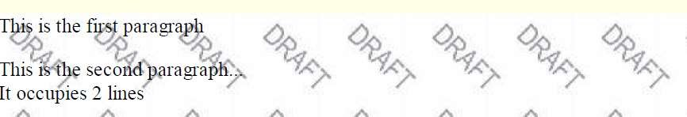
background-image
body {
background-image: url("images/draft.jpg");
}
CSS
background image/color fills the element's content area
CS380

Slide 174

background-repeat
body {
background-image: url("images/draft.jpg");
background-repeat: repeat-x;
}
CSS
can be repeat (default), repeat-x, repeat-y, or no-repeat
CS380

Slide 175
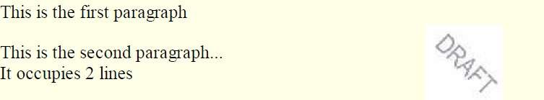
background-position
body {
background-image: url("images/draft.jpg");
background-repeat: no-repeat; background-position: 370px 20px;
}
CSS
value consists of two tokens, each of which can be top, left, right, bottom, center, a percentage, or a length value in px, pt, etc.
value can be negative to shift left/up by a given amount
CS380

Slide 176
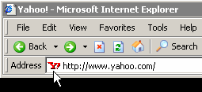
Aside: Favorites icon ("favicon")
<link href="filename" type="MIME type" rel="shortcut icon"
/> HTML
<link href="yahoo.gif" type="image/gif" rel="shortcut
icon" />
HTML
The link tag, placed in the HTML page's head section, can specify an icon
this icon will be placed in the browser title bar and bookmark/favorite
CS380

Slide 177
Cascading Style Sheet.
It is a markup language used in the web document for presentation purpose.
Primary intension of CSS was to separate out the web content from the web
presentation.
Advantages:
By combining CSS with the HTML document, flexibility can be achieved.
Help in managing large scale complex sites.
If CSS is used effectively then global style sheet can be applied to a web document. This
maintains the consistency.
If small changes need to be done in style of web content, then use of CSS is more
convenient.

Slide 178
There are three level of Cascading Style Sheet.
Inline Style sheet
Document level style sheet / Internal Style sheet
external level Style sheet

Slide 179
CSS selectors used to select the specific content which we want to style. Selectors are the internal part of CSS rule set.
CSS selectors chose the different HTML element as per Id, Class, type, attribute.
Type of Selectors:
CSS element selector
CSS Id selector
CSS class selector
CSS Group selector
CSS universal selector : will be apply to all elements

Slide 180
CSS Element Selector
Simple selector form is a single element to which the property and value is applied.
CSS Class Selector
Using class selector we can apply different styles to the same element
CSS Id Selector
The Id selector is similar to the class selector.
CSS Generic Selector
We define the class in generalized form.
Particular class can be apply to any tag.
CSS Universal Selector
This selector can be applied to all the elements in the document

Slide 181
BOOTSTRAP
Why Bootstrap
CSS over Bootstrap
How to Use Bootstrap
Bootstrap Grid System
Bootstrap Responsive
Bootstrap Classes
Bootstrap Components (i.e., Button, Table, List, etc.)
Bootstrap as a Cross Platform.

Slide 182
W3C
What is W3C
How W3C handles/Supports Web Technologies

